Slide 1
Making
Choices for
8th Grade
Ms. Wilkes

Slide 2
Agenda
High School Graduation Requirements
High School Option Programs
Academic Plans
Courses for Next Year
Course Request Forms

Slide 3
Virginia High School
Graduation Requirements
Vocabulary
Credit : You receive 1 credit for passing a high school level class
Verified credit: You receive a verified credit when you pass the high school class AND the SOL for that class
Transcript: record of your grades, attendance, and test scores
Diploma Options
Standard Diploma:
22 credits total
5 must be “verified”
Advanced Diploma:
26 credits total
5 must be “verified”

Slide 4
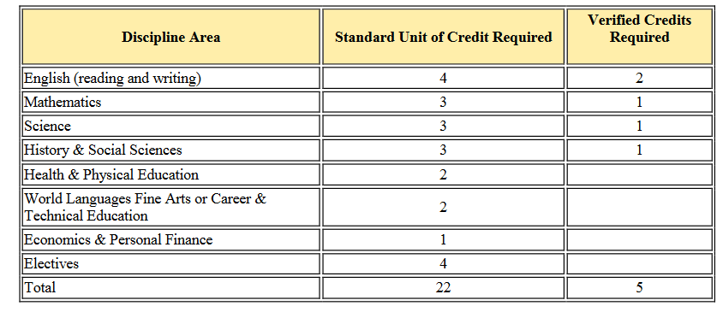
Standard Diploma

Slide 5
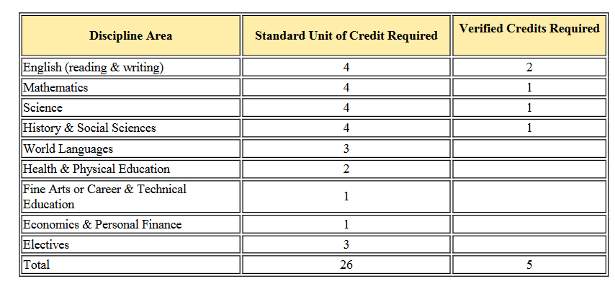
Advanced Diploma

Slide 6
High School Option Programs
International Baccalaureate (IB)
Internationally recognized program of studies available at W-L with a focus on the global perspective
Students who want to transfer submit a pre-IB application during the fall of 8th grade year; no application necessary for W-L students
Lottery system
Must be in Level II of a language and Algebra I in 8th grade
More info: https://washingtonlee.apsva.us/international-baccalaureate-program/

Slide 7
High School Option Programs
Arlington Tech
Rigorous, project-based learning, high school program located at the Career Center for students with focused interest in STEM fields
Students apply in the fall of 8th grade
More info: https://careercenter.apsva.us/arlington-tech/

Slide 8
High School Option Programs
Thomas Jefferson High School for Science and Technology (TJHSST)
FCPS school that provides a comprehensive, rigorous curriculum emphasizing the sciences, mathematics, and technology
Students apply during 8th grade
Students need to take these classes in 8th grade:
Intensified Algebra or Geometry
Intensified Science
Intensified English
Need to have a 3.5 GPA or higher (B+ average) in core classes 7th grade and 1st quarter 8th grade
More info: https://www.fcps.edu/registration/thomas-jefferson-admissions

Slide 9
8th Grade Course Information
All core classes must be passed in order to promote to grade 9
A grade of high C or higher is generally a good indicator that you are ready to move to the next level of math or a world language
High School Credit Courses:
Count toward high school graduation requirements
Appear on your high school transcript that is sent with your college applications
Factored into your grade point average (GPA)

Slide 10
8th Grade Courses
7 Courses Total
English (regular or intensified)
Science (regular or intensified)
Word Geography*
Math
Pre-Algebra for 8th Graders
Algebra I*
Algebra I Intensified*
Geometry Intensified*
Math recommendations made in the spring
*high school credit class
Health and P.E.
2 electives
2 full year courses
OR
1 full year course + 2 semester courses
OR
4 semester courses
* High School Credit Course

Slide 11
Core Classes
Math
Pre-Algebra, Algebra, Intensified Algebra, or Intensified Geometry
English
Regular or intensified
Science
Regular or intensified
World Geography

Slide 12
Full Year Electives
World Languages - Level I or II
*All full-year language courses are high school credit classes.
Spanish
Spanish for Fluent Speakers
French
Latin
Chinese
Arabic

Slide 13
World Language Course Info
All full-year language classes are high school credit courses
The grade and the credit received appear on the high school transcript
These courses are like core classes with nightly homework, quizzes and tests.
If students plan to pursue the International Baccalaureate (IB) diploma, they must be in level two of a language in 8th grade (Spanish II, French II, Chinese II, Arabic II, or Latin II)

Slide 14
Full Year Electives
*high school credit course
Technology of Robotic Design*
Band
Orchestra
Chorus
Yearbook Application required https://forms.gle/S4R2TSpN4qjo64kZ6
Notes:
This course focus on cultivating positive self-esteem; developing skills to build healthy relationships with family, peers, and community members; managing stress and conflict; preparing to become college-and career-ready. Content focuses on self-esteem, values, decision- making and goal-setting skills, interpersonal and family relationships, and vocational planning. Students will:•Identify and analyze how values affect risk behaviors. •Explore the influence of gender roles and stereotypes.•Develop an awareness of choices and challenges.•Learn appropriate relationship behaviors through practicing positive communication and conflict resolution skills.•Participate in parenting activity simulated through the use of a computerized doll.•Explore careers through job-seeking strategies, job requirements and job-site shadowing

Slide 15
Semester Electives
Visual Arts
Theater
Computer & Internet Tech (computer skills)
Life Management (budgeting, cooking, sewing, etc.)
Tech Systems (designing, building, evaluating engineering systems)

Slide 16
Support Electives
Offered by Staff Recommendation
Reading Strategies
Math Strategies
Instructional Studies

Slide 17
Course Request Forms
CRFs will be on Google Forms (no paper forms)
Due Feb. 23rd
You MUST complete this with a parent/guardian!
Link will be posted on Counseling Canvas homepage

Slide 18
How to Choose Electives
You will have 2 elective periods
You can choose a combination of full-year and semester (half-year) electives
Option A: 2 Full-Year Electives | Option B: 1 Full-Year Elective AND 2 Semester Electives | Option C: 4 Semester Electives
Example: Band (full-year) Spanish II (full-year) | Example: French I (full-year) Visual Art (semester) Drama (semester) | Example: Visual Art (semester) Drama (semester) Life Management (semester) Technological Systems (semester)

Slide 19
Course Request Form
will be posted on Canvas!

Slide 20
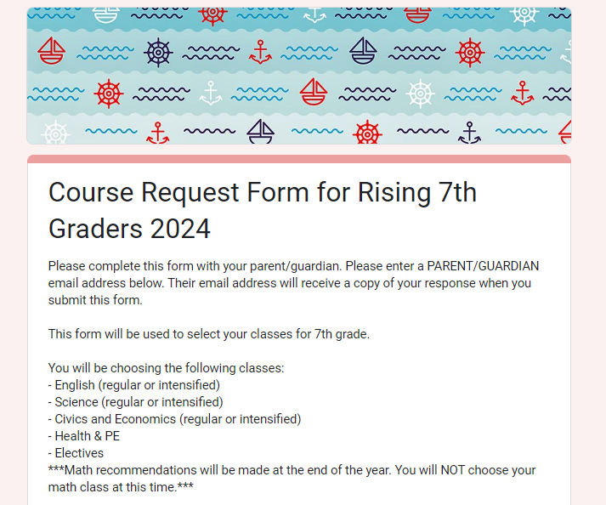
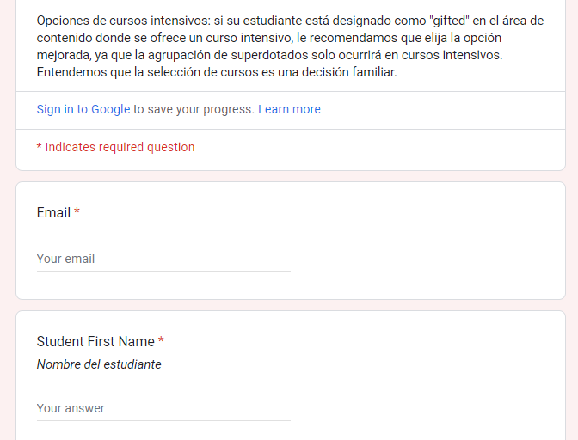
Elective Course Request Form
Insert elective options screenshot
Complete with a parent/guardian!
PARENT email address

Slide 21
Final Notes
Elective Selection Google Form will be posted on the Counseling Canvas page
Google Form is due February 23rd
Only submit the form ONCE!! If you need to make changes later, Canvas message me or have your parents email me.
Check that you are enrolled in the Counseling Canvas page by scanning this QR code:

Slide 22
Questions?
Ask now or message me on Canvas!

