Slide 1
Welcome to Swanson!
Rising 6th Grade Presentation

Slide 2
Quick Facts
School colors
Maroon and White
School mascot
Admiral
Current enrollment
~900 students

Slide 3
Current Schedule
A Day | B Day | Anchor Day
Period 1 | Period 2 | Period 1
Period 3 | Period 4 | Period 2
Period 5 | Period 5 | Period 3
RA & AT | RA & AT | Period 4
Lunch | Lunch | Period 5
Period 7 | Period 6 | AT
 |  | Lunch
 |  | Period 6
 |  | Period 7
7:50-2:35
Swanson uses a “Block Schedule”
A day, B Day, Anchor Day
Three teams in 6th grade (Schooners, Navigators, & Clippers)
*subject to change

Slide 4
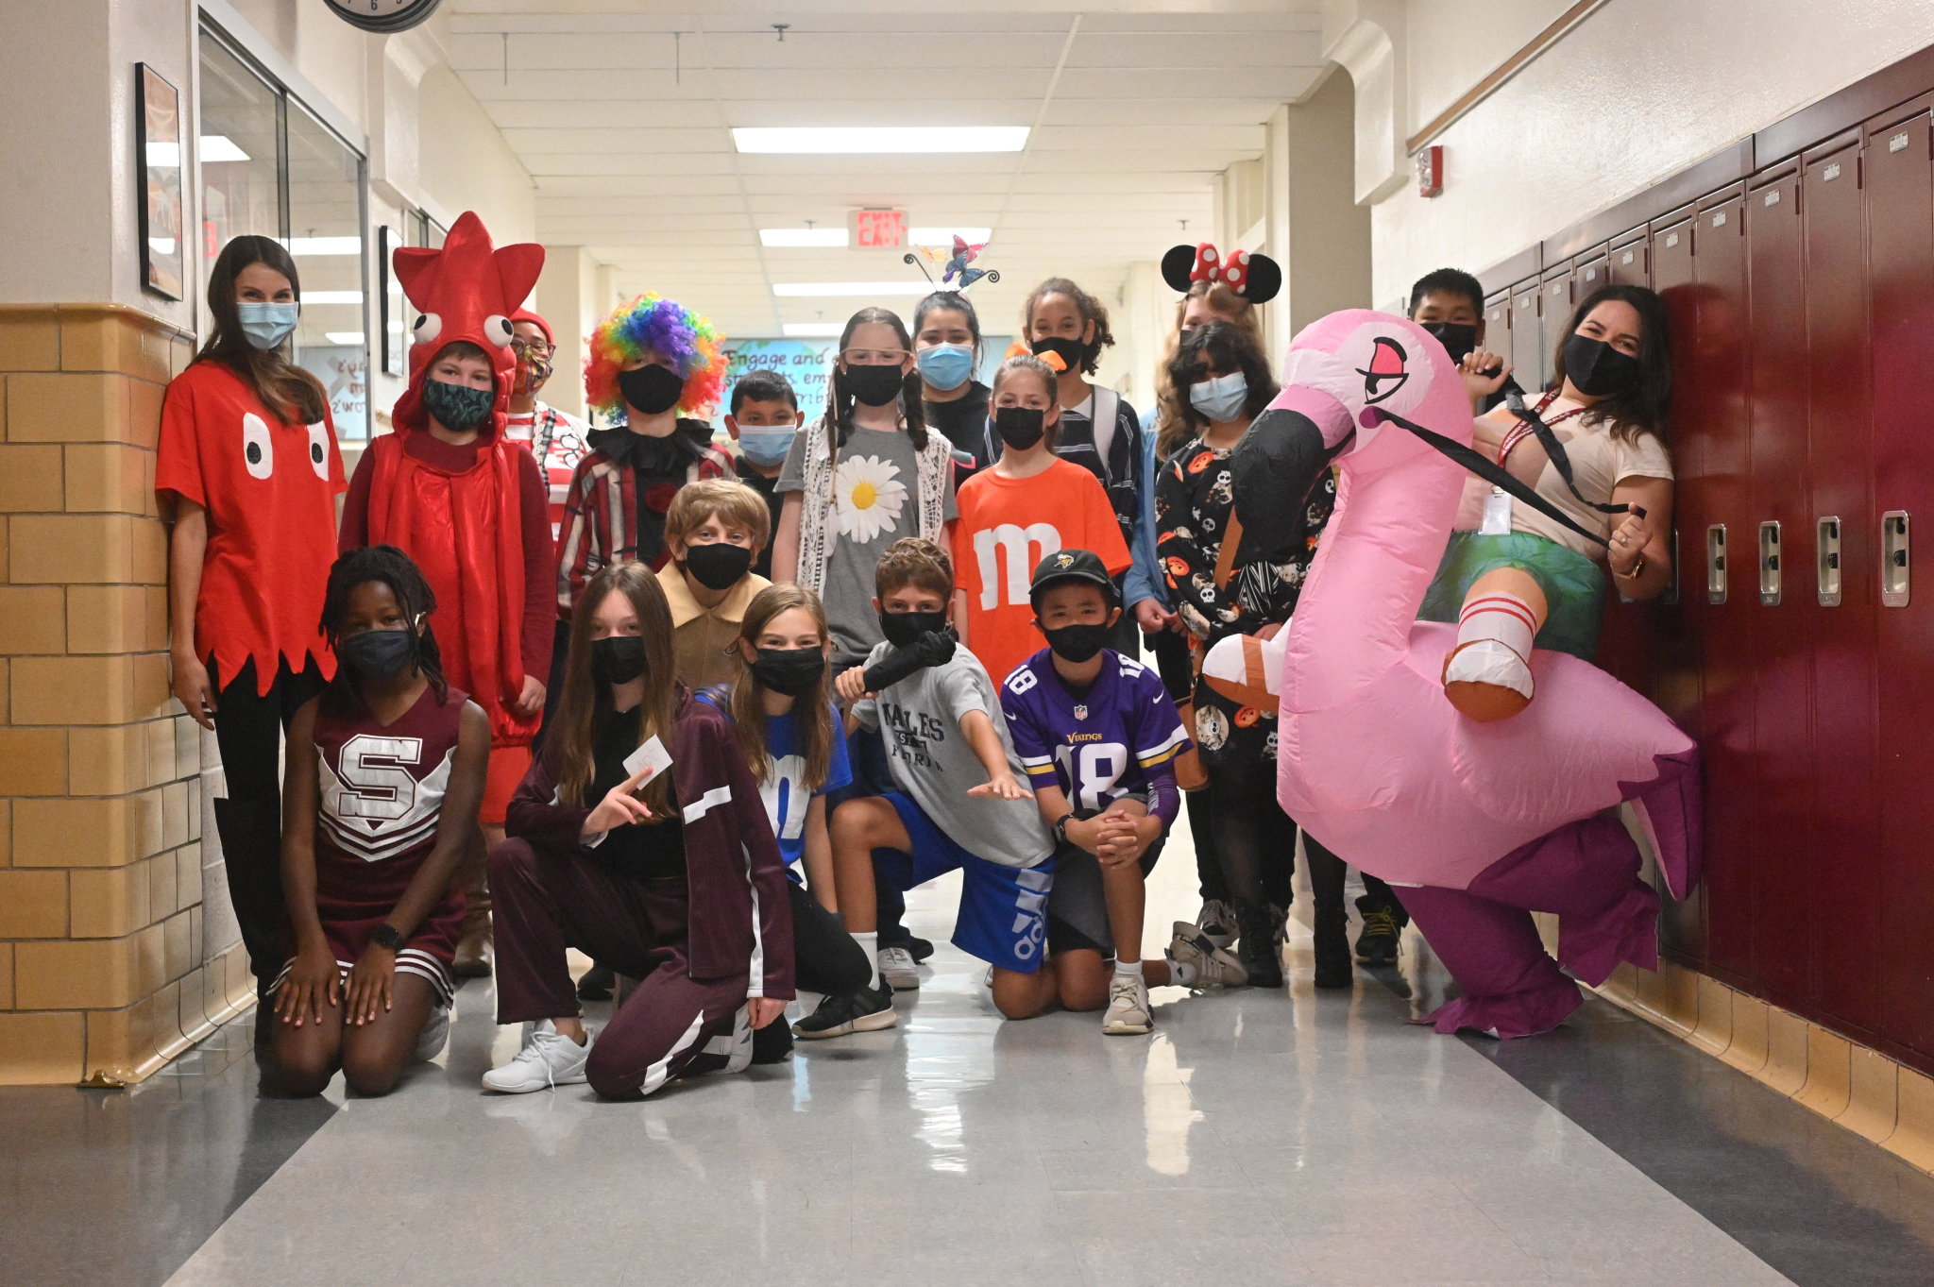
Responsive Advisory/Admirals Time
Homeroom class
RA: Responsive Advisory lessons
AT: Academic/reading time and academic support opportunities
Locker is assigned

Slide 5
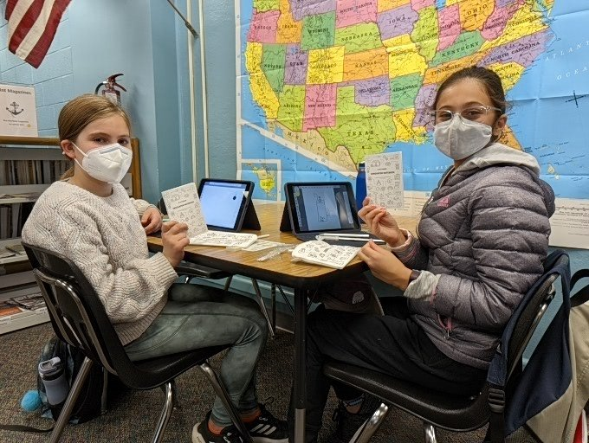
6th Grade Courses
All 6th grade students take:
English (regular or intensified)
Science (regular or intensified)
History (regular or intensified)
Disciplinary Literacy (full-year OR half-year paired with a language)
Math (recommendations made in June/July)
Health & PE-(change out to PE shirt; combination lock)
Elective

Slide 6
6th Grade Intensified Course Options
English, History, Science
A “deeper dive” into the subject
You do not need a recommendation - family decision
You don’t have to choose all intensified or all regular - you can choose 0, 1, 2, or 3 intensified classes!

Slide 7
What are intensified courses, and what are they not?
Intensified Courses Are |  | Intensified Classes are Not
 | Intensified English, science, and social studies courses will offer a chance to go deeper into content/standards. |  | Intensified English, science, and social studies courses are NOT accelerated courses that go beyond grade level content.
 | Intensified English, science, and social studies courses will not require prerequisite classes. |  | There will be the flexibility to opt into the intensified English, science, and/or social studies courses each school year in middle school without prerequisite requirements.
 | Teachers will use resources designed for rigor and CCT strategies regularly to add depth and complexity within the existing curriculum. |  | Intensified courses will use the same existing curriculum map and have built in extensions to support going deeper into the standards
 | Intensified Courses will be open to all learners. |  | Intensified courses are NOT exclusionary and will be offered in settings that support all types of advanced learners.

Slide 8
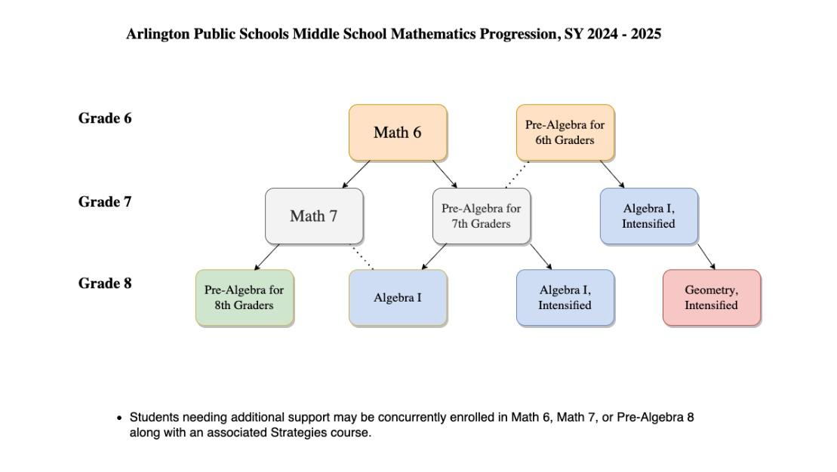
Math Progression

Slide 9
6th Grade Language Classes (optional)
Semester (half-year) Language paired with semester Discplinary Literacy
Could be 1st or 2nd semester
Introduction to a language
NOT for high school credit
Language options:
Intro to French
Intro to Latin
Intro to Spanish
Spanish for Fluent Speakers for 6th Grade

Slide 10
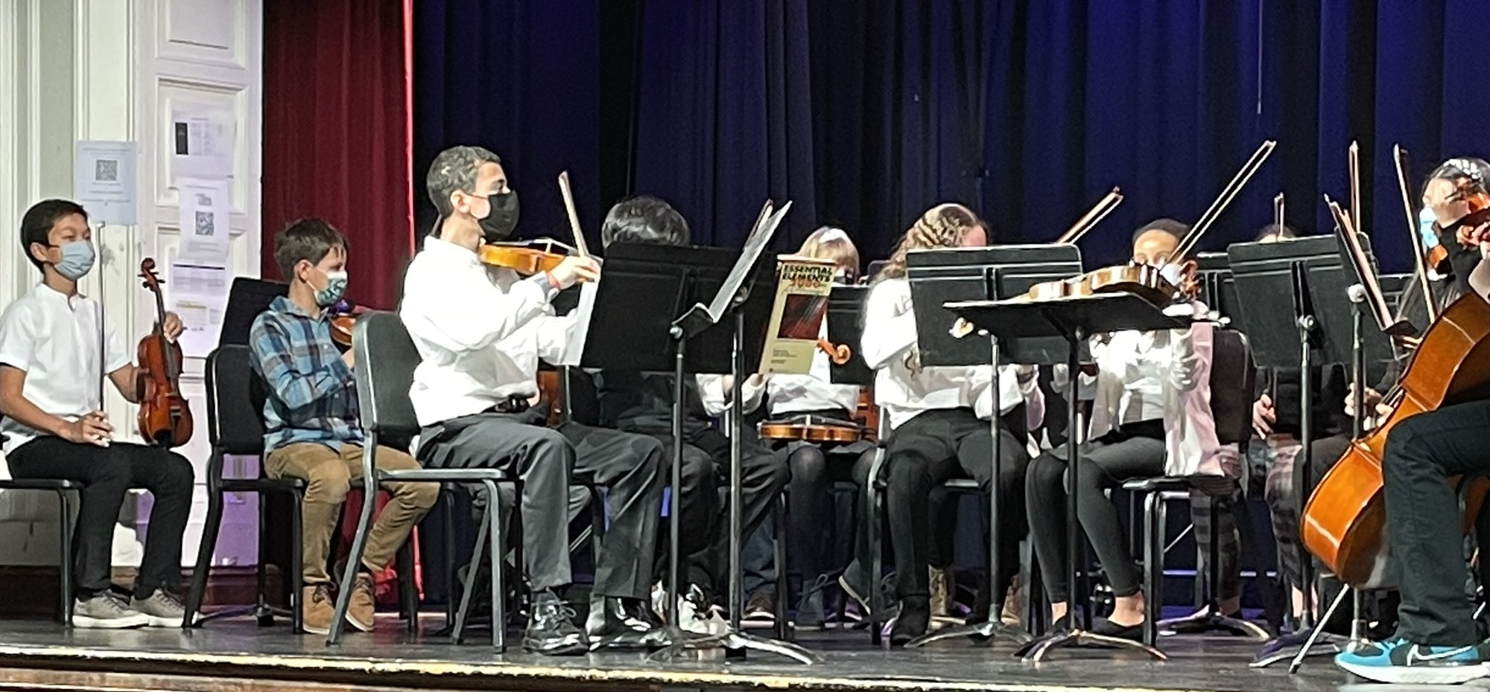
6th Grade Electives - CHOOSE 1
Band
Orchestra
Chorus
Admiral’s Wheel
Rotation of elective classes (approx. 1 class each quarter)
Typically includes Art, Drama, Technology Education, Keyboarding, Family & Consumer Science, etc.
Courses change each year based on staffing

Slide 11
Choosing 6th Grade Courses
Google Form
You will only be choosing:
Disciplinary Literacy - full year or half year paired with language
English - regular or intensified
Science - regular or intensified
History - regular or intensified
Elective - Admirals’ Wheel, Band, Orchestra, or Chorus (choose 1)
Submit Google Form by February 23rd

Slide 12
Course Request Process
You will receive the Google Form from your school in February
The Google Form will ask for a parent email address - you will receive an electronic copy of your submission at that email address
Complete the form ONLY ONCE! If you need to make changes later, email Laura.Goodwyn@apsva.us or Melissa.LaraOrtiz@apsva.us
Submit form by February 23rd

Slide 13
Course Request Google Form

Slide 14
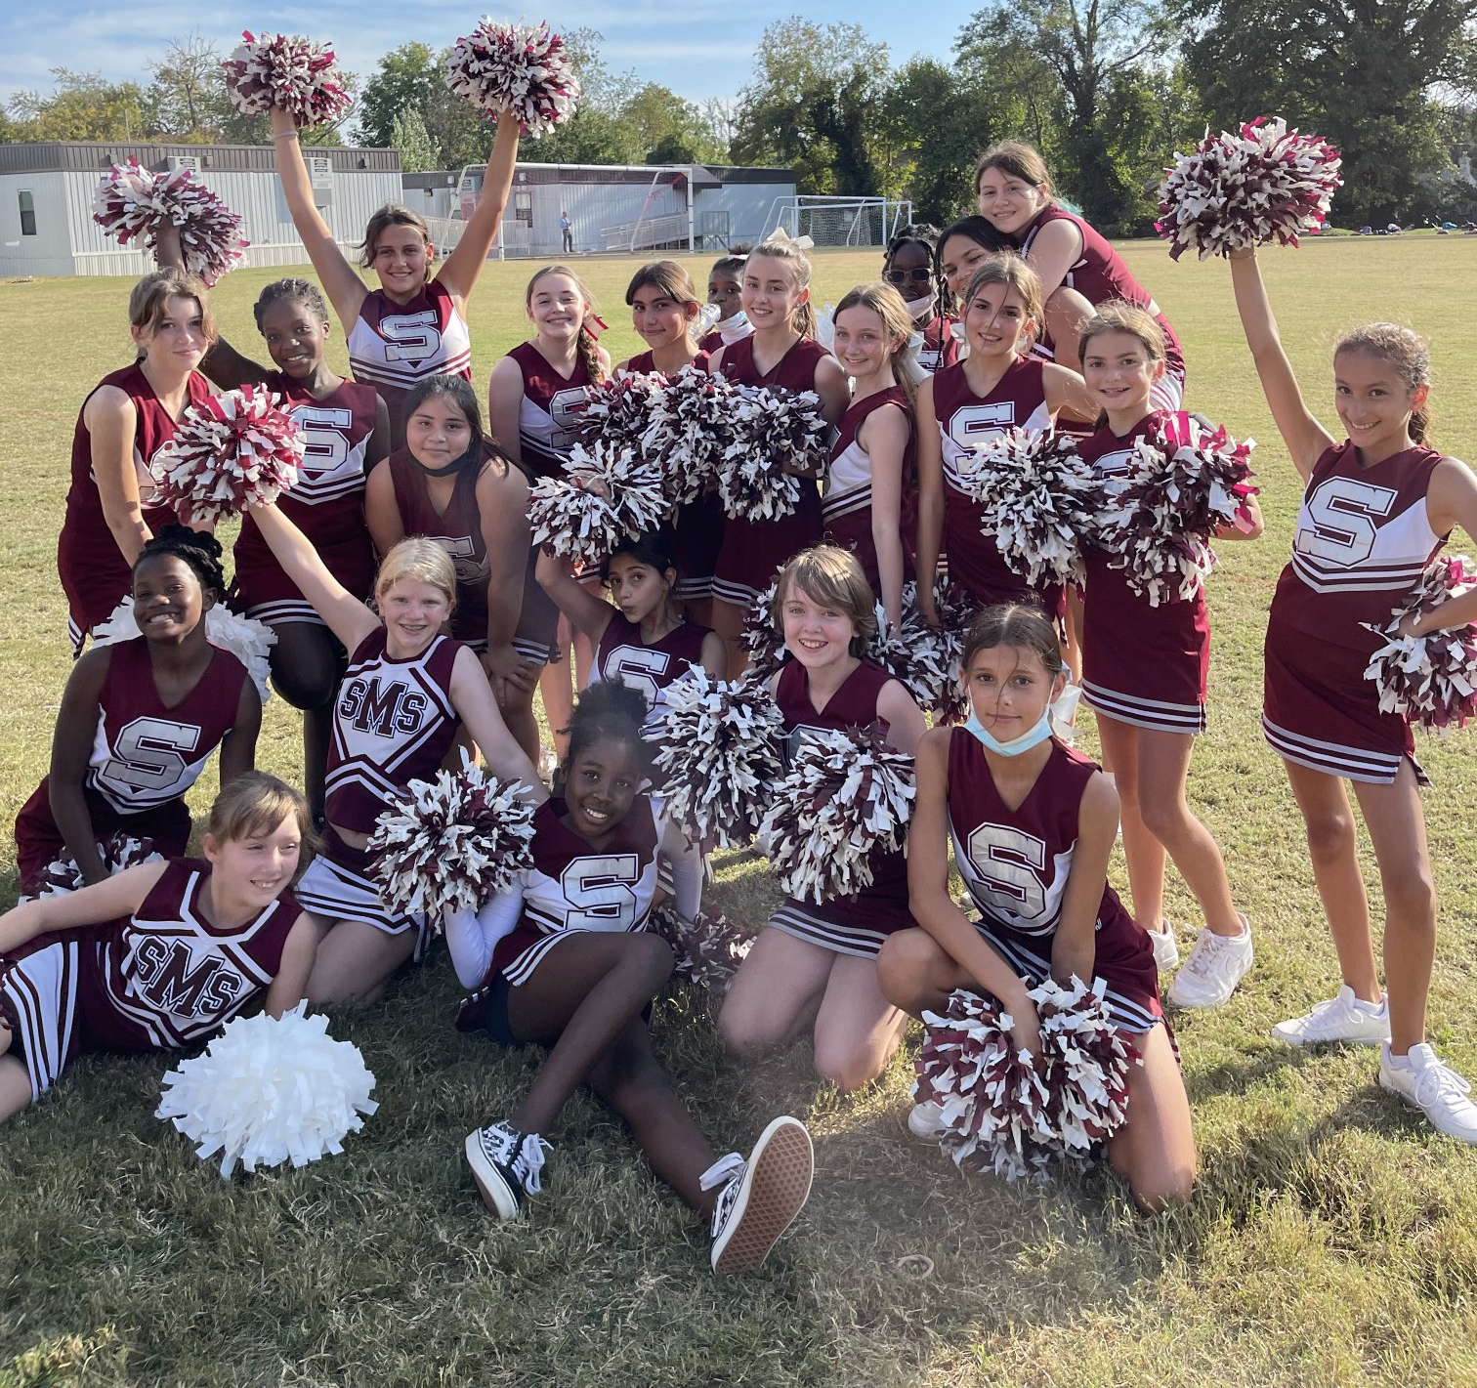
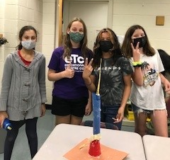
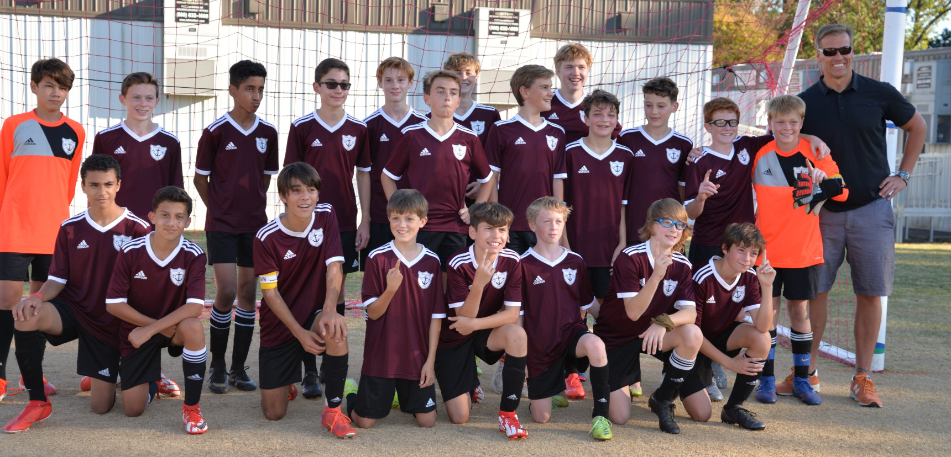
After School Activities
Clubs
Sports
Act II Classes
Check-In (Extended Day)
There is a late bus at 4:15 for students who receive bus transportation

Slide 15
Clubs
Club offerings change each year depending on staffing and student interest
Most clubs meet 1 day per week after school from 2:35-3:30
Clubs are considered “drop-in” - students do not have to attend every meeting
Students can start a new club by talking to Mr. Holland!
Recent Club Examples:
French Club | Game Club | Anime Club
Taylor Swift Club | Gender & Sexuality Alliance (GSA) | Wavelength (Literary Magazine)
Sisterhood | Math Counts | Talking About Books (TAB)
Latina Youth Leading at Swanson (LYLAS) | Swanson Young Activists | Pep Band
Magic: The Gathering Club | Technology Student Association | …and more!

Slide 16
Sports
Soccer*
Tennis*
Ultimate Frisbee
Cheerleading*
Basketball*
Wrestling
Swimming
Track & Field
* = tryout required
Students must have an up-to-date (within a calendar year) Sports Physical on file before participating in a Swanson athletic team
Sports Physical Form: https://swanson.apsva.us/athletics/forms/
Teams have practice/games 4-5 days per week during the season

Slide 17
Act II Classes
Weekly elective class
1 day per week - after school
Attendance is taken and students receive a grade
Offerings change each year based on staffing availability
Recent classes have included Core Plus (study skills & organization) and Band

Slide 18
Check-In (Extended Day)
After-school care from 2:35-6:00 PM
Register through APS Extended Day office for a fee
Activities are self-directed
Students can participate in sports, clubs, ACT II classes, and other activities during this time.

Slide 19
Transition Activities
Rising 6th Grade Parent Information Night
Counselors will visit elementary schools present to 5th grade students in late January/early Feb.
5th graders will visit Swanson in early April
Summer Tours/Info Sessions - Dates TBD
Rising 6th Grade Open House in August
*subject to change

Slide 20
Important People to Know at Swanson
Ms. Smeenk - 6th Grade Assistant Principal
meghan.smeenk@apsva.us
Ms. Goodwyn and Ms. Ortiz - 6th Grade Counselors
laura.goodwyn@apsva.us & melissa.laraortiz@apsva.us
Ms. Partridge- math coach
laura.partridge@apsva.us
Ms. Chiu- reading coach
cynthia.chiu@apsva.us
Ms. Field -advanced academic coach
whitney.field@apsva.us
Stop by their offices to say hi, or send them a Canvas message!

