Slide 1
Welcome to Swanson Middle School

Slide 2
Me
Announcement:
Hello Admirals. I want to welcome you to the 23/24 school year and to Swanson Middle School. This morning we are going to learn what it means to be a Swanson Admiral. You will have an opportunity to share your thoughts throughout the presentation. We’re going to practice sharing with an “elbow buddy” and then returning our attention to the presentation. The chime will signal that it’s time to listen
Let’s practice:

Slide 3
Me
Acknowledgement:
Hello, my name is ______________________ and one thing about myself is ________________.
(favorite food, play a sport- instrument- sing- juggle, a twin)
Activity:
At the end of the presentation, share two “takeaways” about being a Swanson Admiral.

Slide 4
Swanson’s Mission
Engage and educate today's students, empowering them to contribute to tomorrow's world.
Notes:
Our mission to all our students is to

Slide 5
Administrative Staff
Principal
Mrs. Loft
Asst. Principals
Ms. Paul, Grade 6- Room 100D
Ms. LiGuidi, Grade 7 - Room 206
Ms. Smeenk, Grade 8- Room 216
Counseling Director
Ms. Luthra- Counselors Suite
Activities Director
Mr. Holland -Room 100E

Slide 6
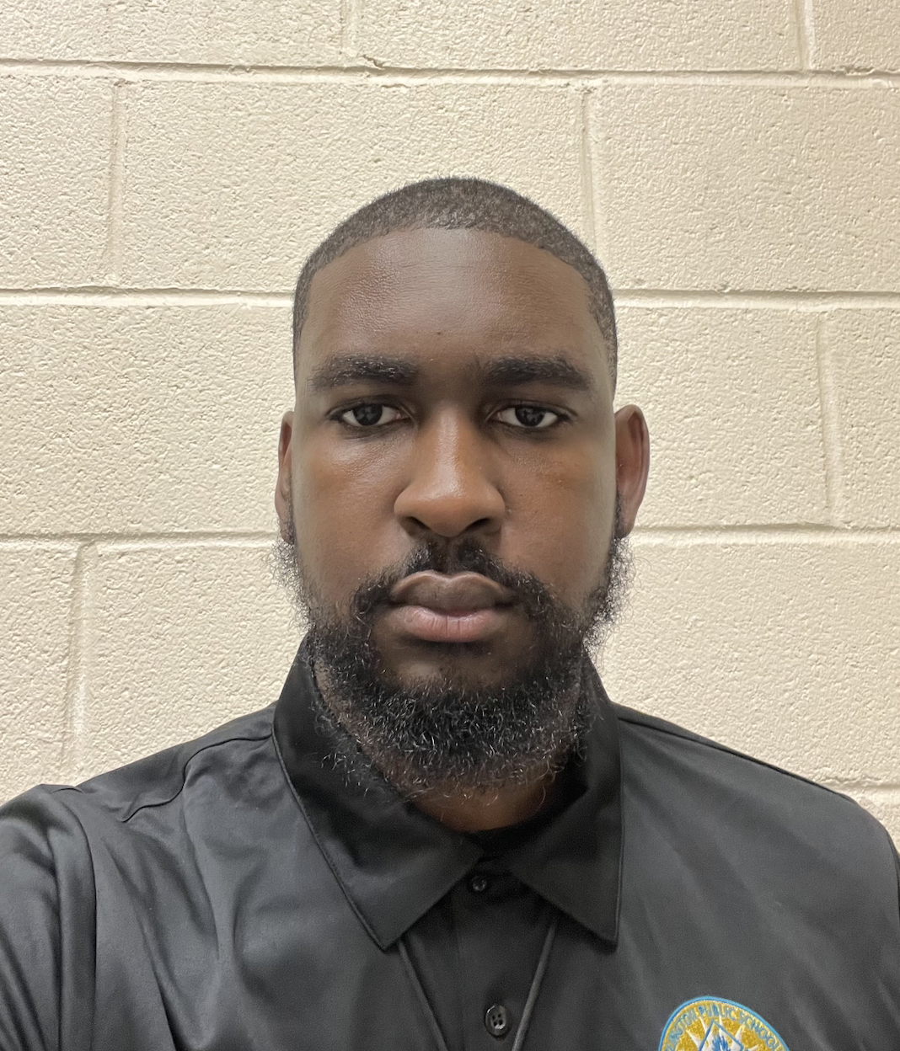
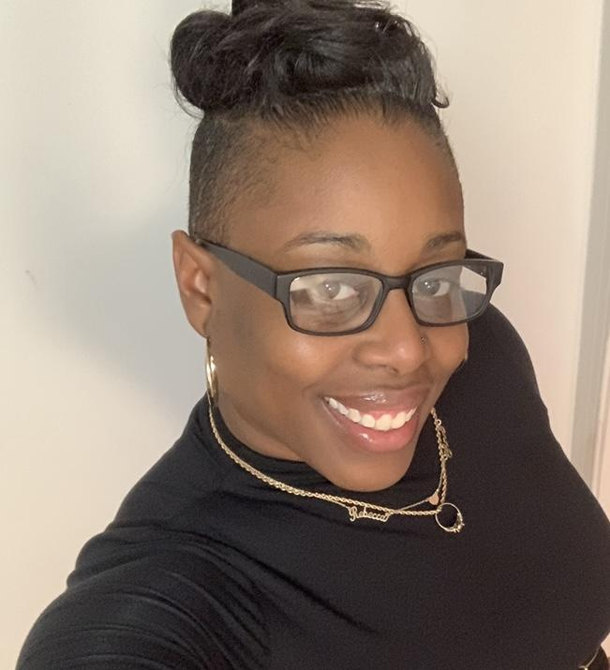
School Safety
Coordinators
Mr. Cooper & Ms. Williams
Room 128A
Assist administrators
Be a positive resource for students, faculty and staff
Ensure the building is safe and secure for the sake of the welfare of all persons present

Slide 7
Who is an Admiral?
Someone who…
Uses kind words and actions towards everyone
Speaks up for themselves and others
Encourages themselves and others to try hard things
Adds to the community in a positive way
Notes:
Introduce Officer Treakle

Slide 8
Swanson Admirals avoid…
Bullying
Harassment
Fighting
Making threats

Slide 9
No Tolerance Policy
Using slurs based upon the actual
or perceived race, ethnicity, color,
national origin, citizenship/immigration
status, weight, gender,
gender identity is not permitted in
Arlington Public Schools.
Notes:
Staff Action Steps for Violators:
Step One: Redirect student behavior, send a message or call parents, inform grade level administrator and Ms. Stallworth (Please submit the violation in the Swanson Discipline Form-under minor)
Step Two: Redirect student behavior, complete Swanson Discipline Form-under major, administrator and Ms. Stallworth will make contact (Consequence One)
Step Three: Redirect student behavior, complete Swanson Discipline Form-under major, administrator and Ms. Stallworth will make contact (Consequence Two)- repeat step as often as needed

Slide 10
Transgender/ Non Binary Student Support
APS policy states that transgender students may use locker room and restroom facilities of their gender identity.
Students who have questions or need support related to gender or sexuality should talk with their grade level counselor or administrator.
No one should feel picked on or bullied. This is a school for everyone!
#EVERYSTUDENTCOUNTS!

Slide 11
THE ADMIRAL’S CODE
RESPECT
Respect YOURSELF and OTHERS. We are kind and respectful to ourselves and to all others we encounter.
RESPONSIBILITY
We are responsible for our shared environments. We take care of our materials and leave all areas clean.
SAFETY
We are a hands-off school! We keep our hands to ourselves and on our own belongings.

Slide 12
Use kind language and actions, even when you disagree
Listen to others
Work together
Admirals are Respectful

Slide 13
Own your actions and consequences
Follow school expectations
Attendance is important for learning! Come to class on time and prepared.
Admirals are Responsible

Slide 14
Hands off, eyes up, hoodies off and devices away
Be safe in person, online and in the community
See something, say something
Admirals are Safe
Notes:
Turn and talk - Why is respect, responsible and safety important? 2 minutes

Slide 15
Construction Safety:
All Construction Areas are off limits for students
Be mindful of construction equipment near cafeteria/soccer field
Admirals are Safe
Notes:
Turn and talk - Why is safety important?

Slide 16
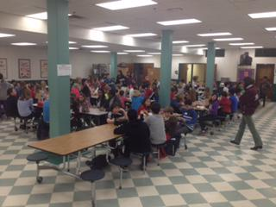
Admirals at lunch
Respect: Include everyone
Responsible: Clean area before leaving
Safe: Eat only in cafeteria
Notes:
Whistle outside to clean up and leave- return sports ball
trash on field- clean it up, even if not yours

Slide 17
Admirals at recess
Respect: Include everyone
Responsible: Return any equipment to staff
Safe: Be aware of other and your surroundings
Notes:
Whistle outside to clean up and leave- return sports ball
trash on field- clean it up, even if not yours

Slide 18
Admirals Mess
Respect: Include everyone
Responsible: Clean area before leaving
Safe: Awareness when entering and leaving
Notes:
Whistle outside to clean up and leave- return sports ball
trash on field- clean it up, even if not yours

Slide 19
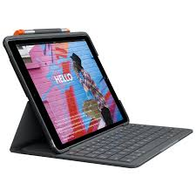
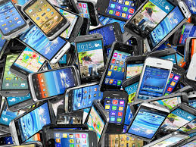
Admirals and Technology
Respect: Personal devices- Off and away
Responsible: School Devices- Charged and ready for class
Safe: Follow “Acceptable Use Policy”
Notes:
1st time - reminder
2nd time- Pick up after school
3rd time- Parent pick up
4th time- Lunch Detention

Slide 20
CELL PHONE, EARBUDS, and/or HEADPHONES POLICY
EARBUDS/HEADPHONES may only be used in class when directed by a teacher and used with school issued iPad.
OFF AND AWAY
7:20 A.M. - 2:35 P.M.

Slide 21
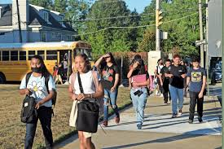
Admirals arriving at school
Respect: Report to your arrival area
6th- Auditorium - Door 1
7th- Small Gym- Door 2
8th- Large Gym- Door 4
Responsible: Personal Electronics off and away
Safe: Walk bikes/skateboards on campus
Notes:
Breakfast in cafeteria- no food outside cafeteria

Slide 22
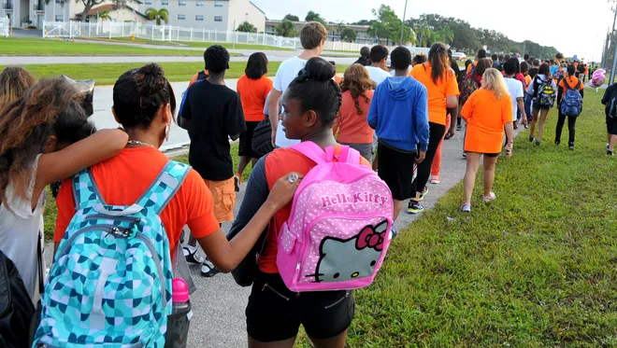
Admirals leaving school
Respect: Be mindful of community
Responsible: Report to bus/ after school immediately
Safe: Listen to Crossing Guard instructions
Notes:
Community- Westover shopping areas

Slide 23
Admirals Learning
Respect:Use kind words and actions
Responsible: Arrive to school/ class on time
Safe: Follow APS “Acceptable Use Policies”

Slide 24
THE ADMIRAL’S WAY
SCHOLARSHIP
We strive to think deeply and with a growth mindset.
We work diligently to achieve success in the classroom and in our community.
SERVICE
We connect to one another, our community, and to the world.
We take care of each other by helping those in need both in our school and in the community at large.
SPIRIT
We celebrate our successes, ourselves, and our school.
People know who we are by our remarkable kindness.
We act in the best interest of our school and our whole community.
Notes:
The code is the expectations- the way is an extension of those expectations.

Slide 25
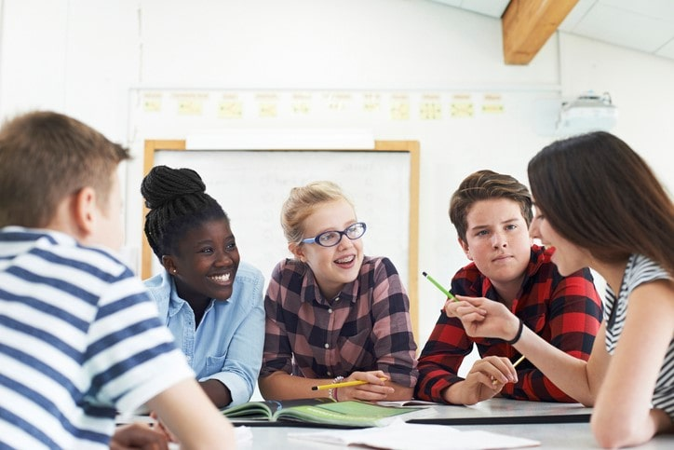
Admirals and Scholarship
We strive to think deeply and with a growth mindset.
Develop good study habits by:
Completing home and classwork
Studying for tests and quizzes

Slide 26
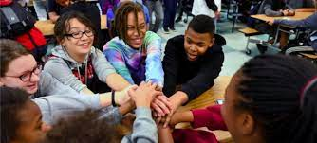
Admirals and Service
We connect to one another, our community, and to the world.
Helping one another to succeed:
Supportive
Understanding
Go beyond yourself

Slide 27
We Are Service
Admirable Admiral!
LYLAS
Sisterhood
GSA
Boys to Men
Student Council
Notes:
Students have several opportunities to serve the Swanson community, surrounding community, and world communities. These groups work to sponsor such events….

Slide 28
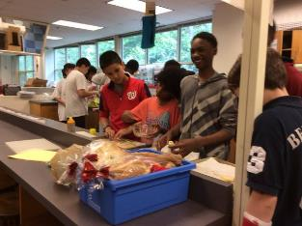
Engaging in Afterschool Activities
ASP 1- Starts at 2:40 PM
Sports practices- 2:40- 4:15 PM
At 3:30, non-bus riders dismissed from ASP1 are to go directly home
At 3:30, late bus riders are to report to ASP2 WITH A PASS FROM A TEACHER; Late bus departs at 4:21 PM
Students are not permitted to remain on school property unsupervised or leave campus and return for late bus transportation

Slide 29
Admirals and Spirit
We celebrate our successes, ourselves, and our school.
Helping one another celebrate successes:
Acknowledge achievements
Accept challenges
Try hard things
Mindset Matters - video
Notes:
Turn and talk at end of video- what does “the Way” look like to you?

Slide 30
6th Grade Counselors
IncMs. Reardon
Ms. Wilkes
7th Grade Counselor
Ms. Reardon
Ms. Wilkes
8th Grade Counselors
Ms. Goodwin
Ms. Ortiz

Slide 31
Me
Activity:
At the end of the presentation, share two “takeaways” about being a Swanson Admiral.

