Slide 1
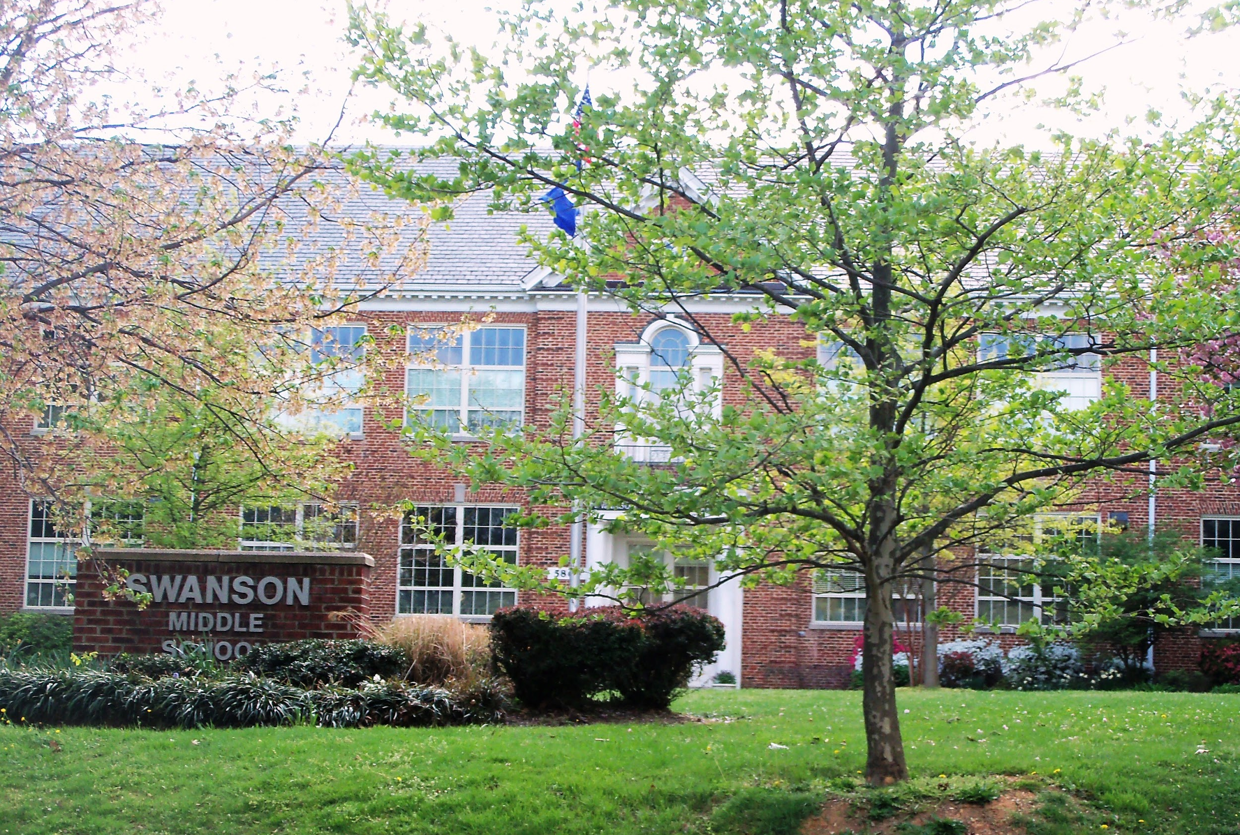
Special Education Services at Swanson
Together we make a difference!

Slide 2
Welcome!
Rene Harber-Current principal
rene.harber@apsva.us
Dr. Marjorie Myers – Interim Principal start date 2/2 marjorie.myers@apsva.us
Blandine Liguidi - 6th Grade Assistant Principal
blandine.liguidi@apsva.us
Laura Porter– 7th Grade Assistant Principal
laura.porter@apsva.us
Dr. Latisha Ellis - 8th Grade Assistant Principal
latisha.ellis@apsva.us
Rana Luthra - Director of Counseling rana.luthra@apsva.us

Slide 3
Welcome!
Melissa Meck - Student Support Coordinator
melissa.meck@apsva.us
Kolleena Perry and Megan Mckeown
Special Education Department Chairs
kolleena.perry@apsva.us and megan.mckeown@apsva.us
School Counselors
Chrissy Reardon - 6th Grade christine.reardon@apsva.us
Laura Goodwyn - 7th Grade laura.goodwyn@apsva.us
Melissa Lara-Ortiz - 7th Grade melissa.laraortiz@apsva.us
Michelle Wilkes - 8th Grade michelle.wilkes@apsva.us

Slide 4
Life At Swanson
We are excited to welcome your child to the Swanson community and will help them experience success in middle school.
We value working collaboratively with you and your child.
Your participation and input in all meetings is very important to us.

Slide 5
Important to know
Case Carriers
People who may contact you
Frequency of Meetings
Testing considerations
Accommodations & Modifications

Slide 6
Case Carriers
We encourage you to work closely your case carrier.
He or she is a major advocate for your child and will keep and collect data and information about how your child is doing in class. Your child’s case carrier will update you on IEP goal progress and will write your child’s IEP.

Slide 7
Who may contact me this year regarding meetings and/or testing?
Your child’s case carrier
Related service providers (speech therapist, occupational therapist, physical therapist, other therapists)
Student Support Coordinator: Melissa Meck
Administrative Assistant: Ingriz Barraza

Slide 8
How often will we meet?
IEP meetings occur at least once per year and can be requested at any time by any team member.
Re-evaluation meetings occur once every three years. (If this is a re-evaluation year for your child, you could meet three or more times this year.)

Slide 9
Re-Evaluations
Our administrative assistant will contact you for a meeting if your child is due for a re-evaluation. The committee will work together to determine if additional data is needed in order to determine eligibility.
**Only you can authorize additional evaluations.

Slide 10
Accommodations and Modifications
Your child’s IEP is implemented throughout the school day. He or she will receive required accommodations and/or modifications in all classes.

Slide 11
Settings
Swanson is a comprehensive middle school that provides specialized instruction matching your child’s least restrictive environment:
Consult/Monitor with General Education staff
General Education classrooms with Special Education support
Small Resource Classes
Countywide Program

Slide 12
Transition Meetings
Transition meetings have started and will continue into the Spring.
We are invited by the elementary school to attend your child’s IEP meeting.
We meet with the team to determine how to best support your child in the middle school environment.
Services may look different in middle school.

Slide 13
Enjoy your evening!
If you have any questions about Special Education at Swanson please contact our rising grade level administrator at
703-228-5500
Ms. Blandine Liguidi-6th Grade
blandine.liguidi@apsva.us
Ms. Laura Porter-7th grade
laura.porter@apsva.us
Dr. Latisha Ellis-8th grade
latisha.ellis@apsva.us

