Slide 1
Join GSA!
All are welcome!

Slide 2
What is the GSA?
Gender Sexuality Alliance (GSA)
A club for students of all sexual orientations and gender identities, including students who identify as LGBTQ and allies!
LGBTQ: Lesbian, Gay, Bisexual, Transgender, Questioning
Sponsors: Mr. Gill and Ms. Goodwyn

Slide 3
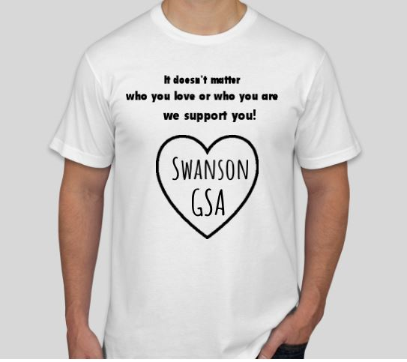
What does GSA do?
Have fun!
Connect with other students and make new friends
Learn about LGBTQ history and culture
Educate Swanson about LGBTQ issues

Slide 4
Join us!
GSA meets every Tuesday starting September 29 from 2:45-3:15 p.m.
Enroll in the Canvas Course to get info on how to join: https://apsva.instructure.com/enroll/DY39D6

