Slide 1
Sisterhood Club
Tuesdays, 3:00-3:30
Sponsor: Ms. Reardon
Canvas Enroll Link: https://apsva.instructure.com/enroll/DY39D6

Slide 2
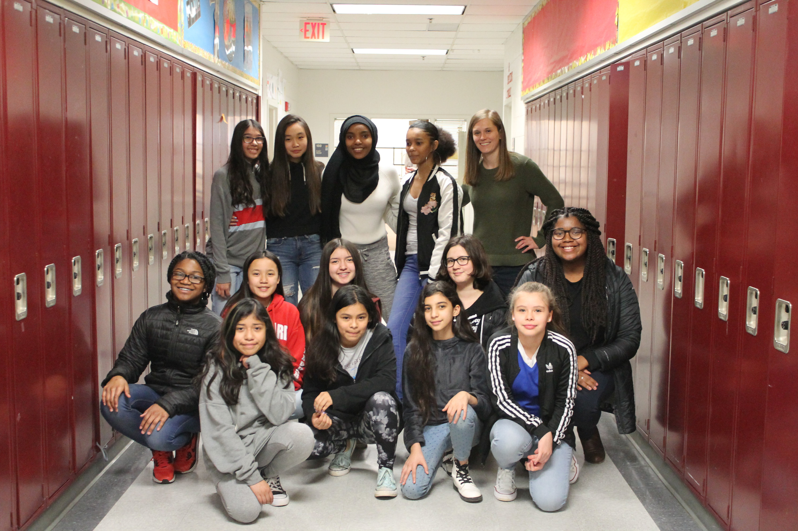
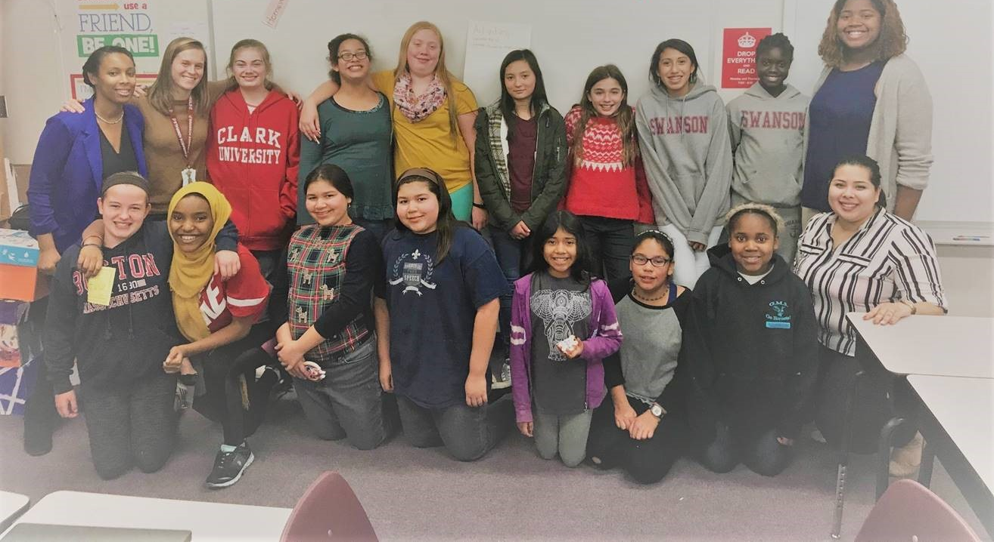
Sisterhood Club is:
A diverse group of Swanson girls
A place to learn about powerful & influential women
An opportunity to become a leader
A place to celebrate each other
An opportunity to give back to our community
A place to have FUN!

Slide 3
