Slide 1
BoyzIIMen
Sponsors: Mr. Berman, Mr. Farrell, and Mr. Murray

Slide 2
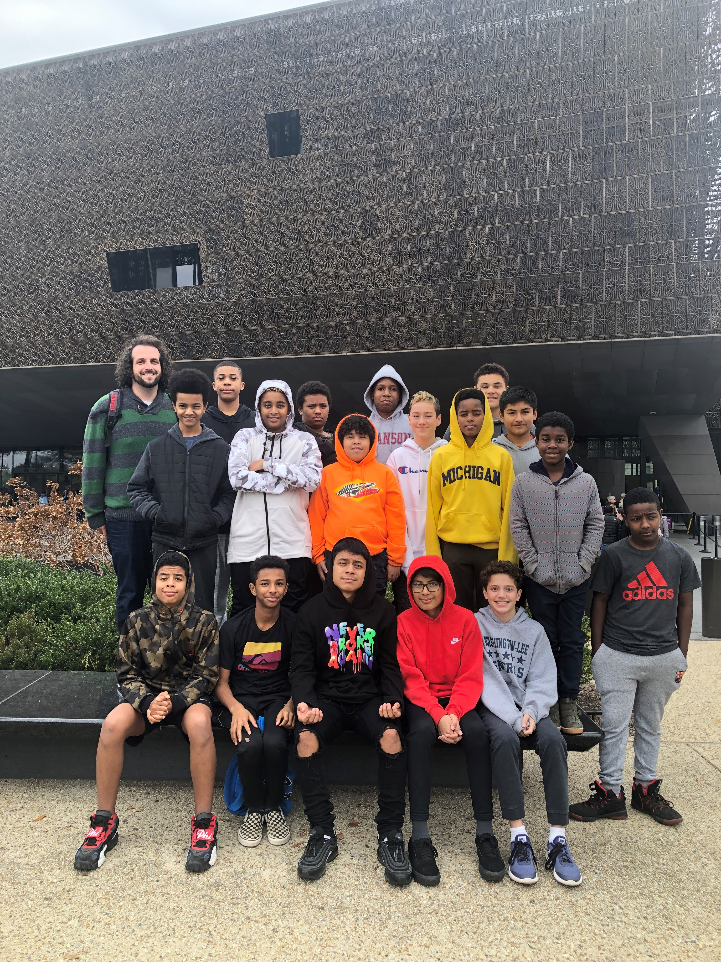
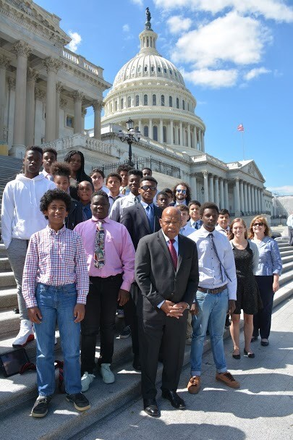
BoyzIIMen is:
A diverse group of Swanson’s boys.
A safe space for students to discuss current events as they relate to race, ethnicity, religion, LGBTQIA+, and intersectionality.
An opportunity to develop leadership and teamwork skills.
A place to learn about and meet great positive leaders and role models.
A place to meet and develop strong friendships
FUN!

Slide 3
Self-Enroll Code

