Slide 1
MATH COUNTS Ms. Partridge - SPONSOR
For sTUDENTS interested in math problem solving

Slide 2
Do you Like Math Games?

Slide 3
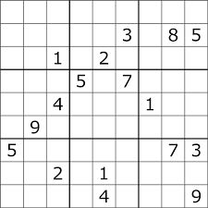
DO YOU LIKE MATH PUZZLES?

Slide 4
Do YOU LIKE MATH CONTEST PROBLEMS?

Slide 5
If yes, was your answer to any of the questions, then Math Counts is a club you may enjoy!
MATHCOUNTS DETAILS: Open to any student
CANVAS COURSE that you can access at anytime
TEAMS CLUB MEETING 2:45-3:30 ONCE A WEEK STARTING IN OCTOBER
YOU DO NOT HAVE TO ATTEND EVERY MEETING – it is come when you can
Virtual math competitions opportunities

Slide 6
IF INTERESTED, PLEASE DO THE FOLLOWING this week:
STEP 1: Join the MathCounts Canvas course if you joined last spring you should still be a member
https://apsva.instructure.com/enroll/BHL73X
STEP 2: Do the SURVEY in the MathCOunts Canvas Course – directions will be on the home page.
Will ask about meeting day preference (Most likely will be Thursday)
Will ask if you are interested in possibly participating in a virtual competition
this is not a requirement, but I need to find out interest level now

Slide 7
QUESTIONS?
EMAIL Ms. Partridge at
laura.partridge@apsva.us

