Slide 1
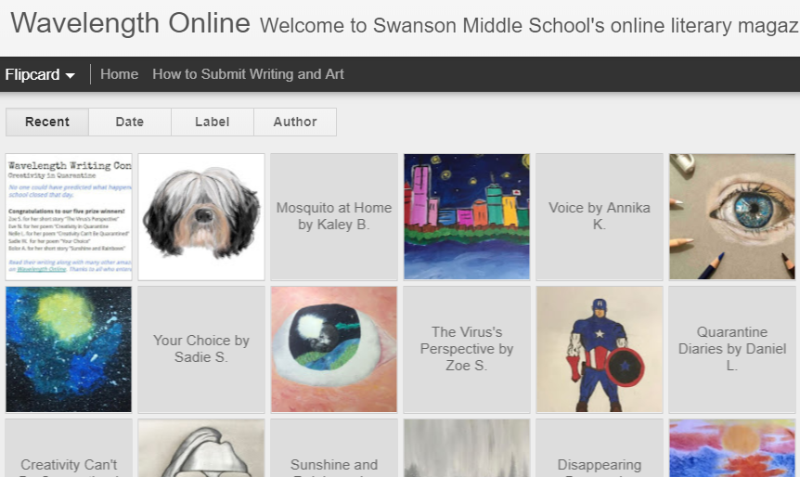
Join Wavelength!
Swanson’s Literary Magazine
Meetings on Thursdays after school beginning October 1 on Microsoft Teams
Writing and art activities
School-wide writing & art contests
Select and publish creative work on Wavelength Online
All are welcome--come when you can!
Message Ms. McFarlane with any questions: leah.mcfarlane@apsva.us
Linked to the Swanson Homepage
http://swansonwavelength.blogspot.com

