Slide 2
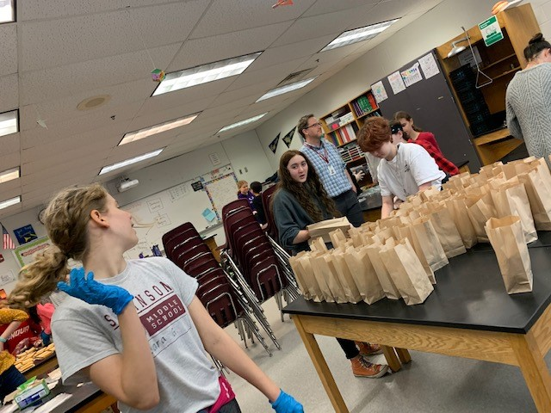
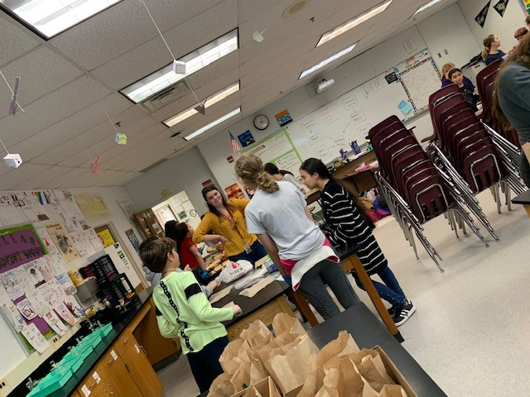
LYLAS partnered with GSA & A-SPAN (Arlington Street People’s Assistance Program) to bag lunches for the homeless. Both groups (LYLAS & GSA) raised money to buy supplies such as bread, deli meat, cheese, pretzels, and water to make this project possible.

Slide 3
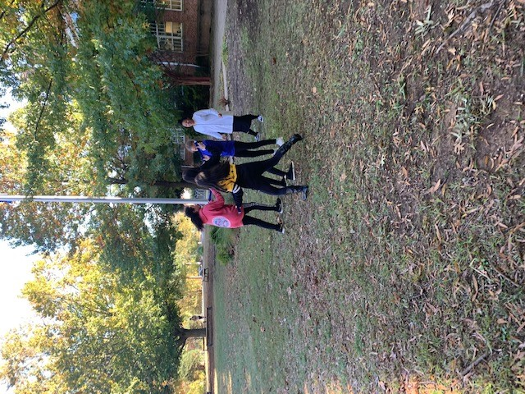
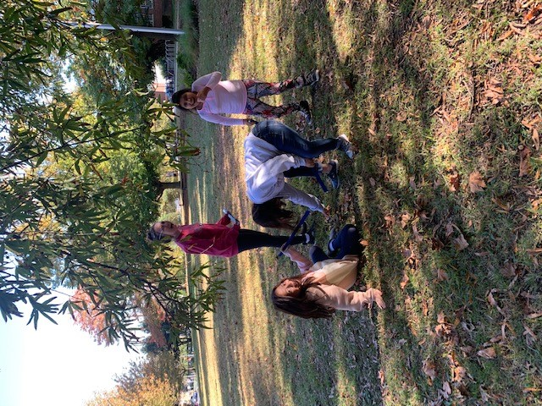
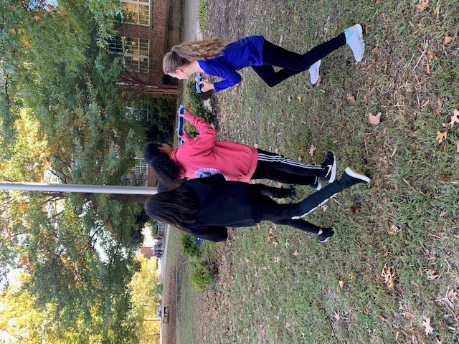
Our Group loves to do outdoor team building activities. Where they can learn to work together, communicate respectively, and practice being patient.

Slide 4
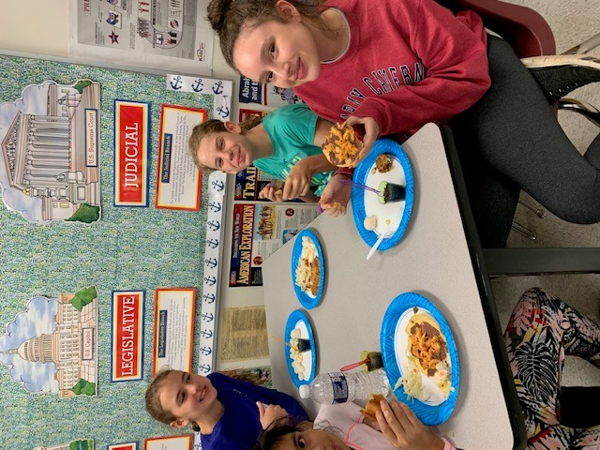
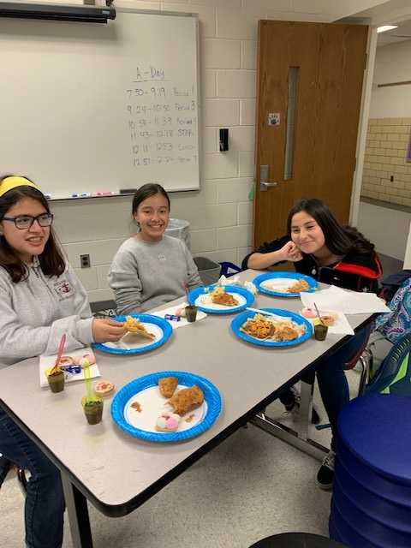
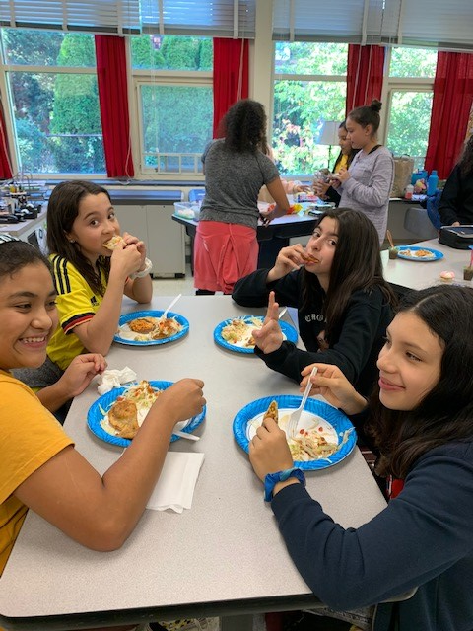
LYLAS members love to share food from their country and family recipes! We plan activities that gives everyone the opportunity to connect and learn from each other.

Slide 5
Interested in joining?
-When Do We Meet? Mondays 2:30-3:00pm
-Who Are The Sponsors? Mrs M. Ortiz and Mrs K. McGhee
-Description of LYLAS: Focuses on empowering and creating leadership opportunities for our girls of Latino/Hispanic heritage through the celebration and exploration of culture.
For questions contact Ms. Ortiz (melissa.laraortiz@apsva.us) or Ms. Ghee (karla.mcghee@apsva.us).
Self Enroll code: https://apsva.instructure.com/enroll/BCB9PM
Teams Link to join Mondays 2:30-3:00pm: https://teams.microsoft.com/l/meetup-join/19%3ameeting_MjlkNTAxZTQtMjg0ZS00ZjlhLWIzOWYtY2UxNmJiOGEwZjQ3%40thread.v2/0?context=%7b%22Tid%22%3a%22313708a6-b7e9-492c-ac7a-f19734f3f702%22%2c%22Oid%22%3a%2291b54bee-d2f0-4d54-8218-dc307f6db176%22%7d

