Slide 1
Making Choices for 8th Grade
Swanson Middle School
Academic Planning Presentation

Slide 2

Agenda
Instructional Model
Graduation Requirements
Academic Plans
Courses for Next Year
Course Request Forms

Slide 3
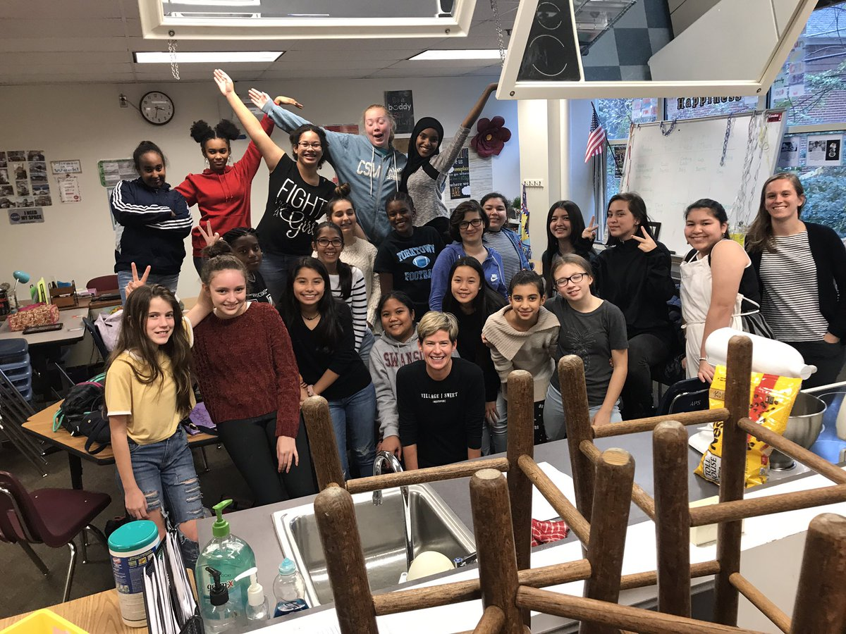
Quick Facts
Current Enrollment- 1,252 students
2019-20 Projected Enrollment- 1,075 students
Grade level Team Communities

Slide 4
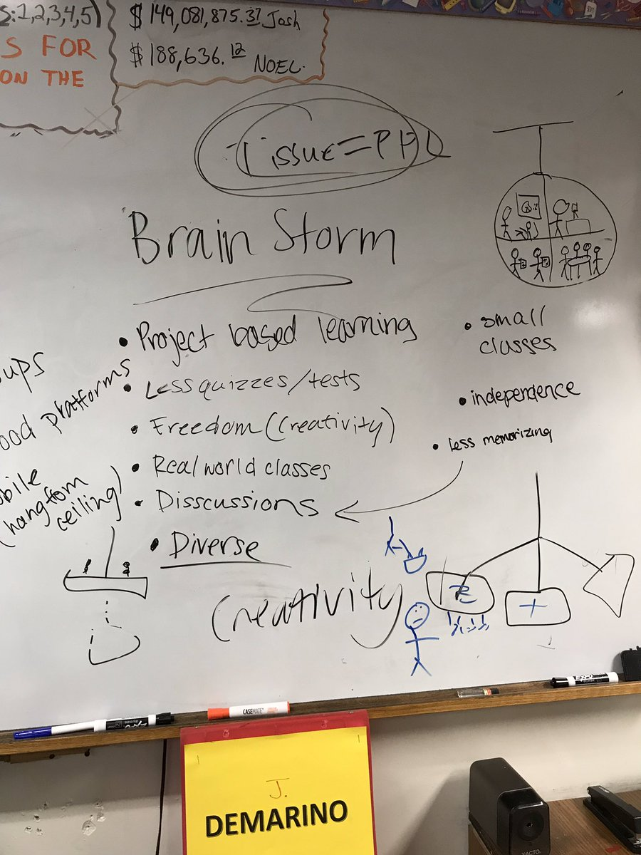
Our Instructional Model
2019-20 Swanson will shift to delivering instruction through a “block” model.
School-wide professional learning this year has devoted to studying how to best meet needs of all students

Slide 5
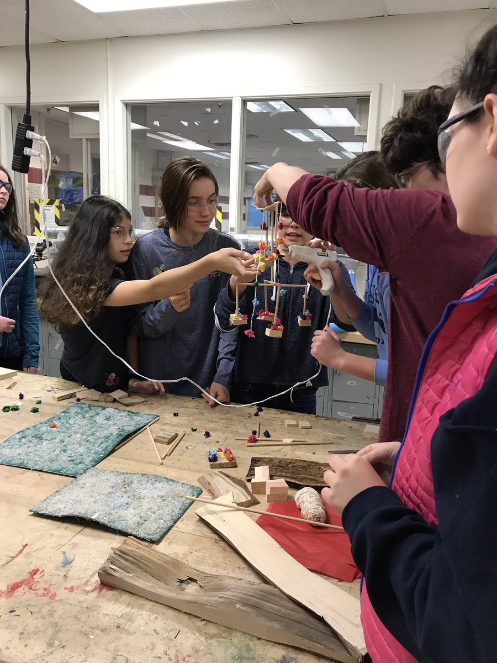
Our Instructional Model:
Staff key takeaways
Less rush/less transition time, more days to complete homework, less stress for teachers and students, common planning time for teachers
More time for processing
Opportunities for deeper relationship with students

Slide 6
Two Diploma options
Standard Diploma
        22 credits, 5 verified*
Advanced Diploma
        26 credits, 5 verified*
Credit: you receive a credit for passing a class
Verified credits: you receive a verified credit when you pass a class and the SOL test for that class
Transcript: record of your grades, attendance, test scores
  *Verified credit requirements recently changed

Slide 7
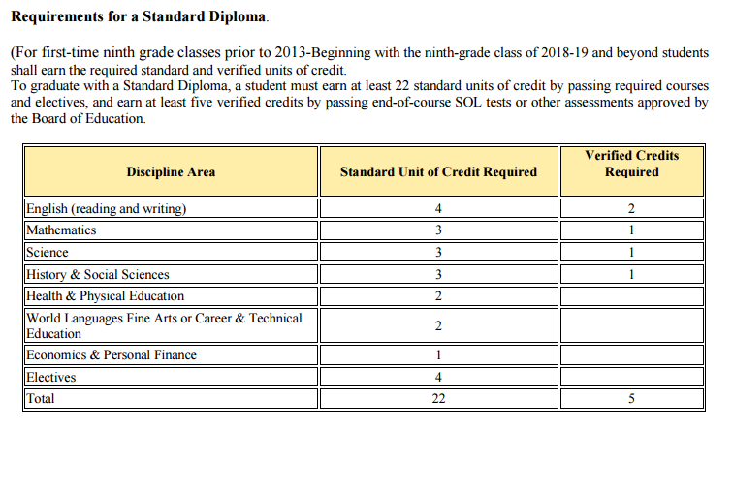
Standard Diploma

Slide 8
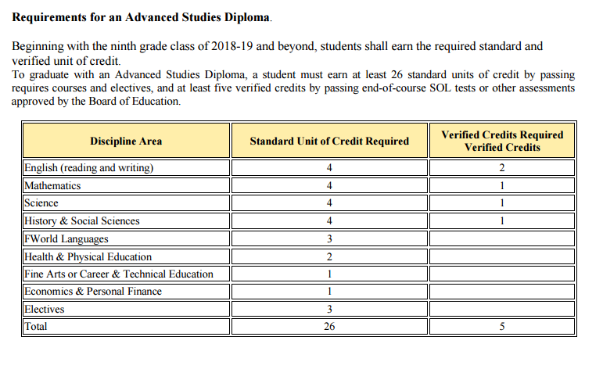
Advanced Studies Diploma

Slide 9
High School programs and opportunities
International Baccalaureate (IB)
Internationally recognized program of studies available at W-L with a focus on the global perspective
Students who want to transfer submit a pre-IB application during the fall of 8th grade year; no application necessary for W-L students
Must be in Level II of a language and Algebra I in 8th grade
  https://washingtonlee.apsva.us/international-baccalaureate-program/
AP Scholars
Program for high-achieving students at Yorktown that provides them with enrichment opportunities and mentoring; requirement 2 or more Intensified classes in 9th grade and 6 or more AP classes in 10th-12th grade
  https://yhs.apsva.us/academics/yorktown-ap-scholars/
Students will receive information about and submit applications for all programs in the fall of their 8th grade year

Slide 10
High School programs and opportunities
Arlington Tech
Rigorous, project-based learning, high school program located at the Career Center for students with focused interest in STEM fields
  https://careercenter.apsva.us/arlington-tech/
Thomas Jefferson High School for Science and Technology (TJHSST)
FCPS school that provides a comprehensive, rigorous curriculum emphasizing the sciences, mathematics, and technology
  https://www.fcps.edu/registration/thomas-jefferson-admissions
Students will receive information about and submit applications for all programs in the fall of their 8th grade year

Slide 11
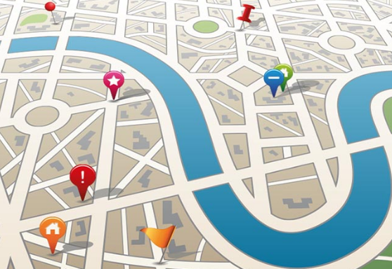
Academic plans
APS students will complete or add to an academic plan every year
Serves a road map to see what classes are required
Plan will be sent home to families

Slide 12
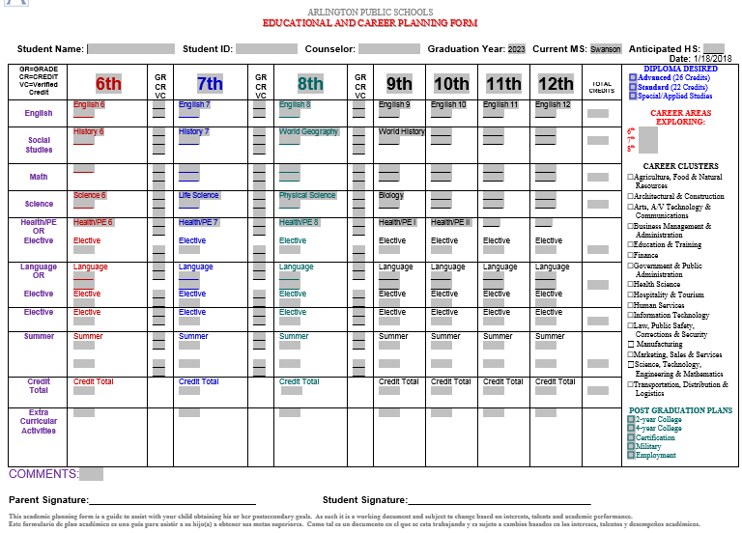

Slide 13
8th grade information
All core classes must be passed in order to promote to grade 9
A grade of high C or better is generally a good indicator that the student has the foundation to be successful in the next math level
High school credit courses information
courses count toward high school graduation requirements
grades appear on your high school transcript that is sent with your college applications
grades are factored into your grade point average (GPA)

Slide 14
Course Requests for 8th Grade
Four core subjects:
  English
  Science
  Word Geography*
  Math
    Pre-Algebra for 8th Graders
    Algebra I*
    Algebra I Intensified*
    Geometry Intensified*
  Health and P.E.
  Two electives
      * High School Credit Course

Slide 15
FULL YEAR ELECTIVES
World Languages
  All full-year language courses are high school credit classes.
Level I or II of:
  Spanish
  Spanish for Fluent Speakers
  French
  Latin
  Chinese (Distance Learning)
  Arabic (Distance Learning)
  American Sign Language (Level 1 only)
    ASL is subject to staffing availability. Students MUST choose an alternative World Language.

Slide 16

WORLD LANGUAGES
All full-year language classes are high school credit courses
The grade and the credit received appear on the high school record, also known as the transcript, that is sent to colleges
These courses are like core classes with nightly homework, quizzes and tests.
If students plan to pursue the International Baccalaureate (IB) diploma, they must be in level two of a language in 8th grade (Spanish II, French II, Chinese II, Arabic II, or Latin II)
There are no “Intensified” Level II classes.

Slide 17
Full year electives
  Band
    Intermediate (Symphonic)
    Advanced (Wind Ensemble)
  Chorus
    Intermediate
    Advanced
  Orchestra
    Beginning
    Advanced
Journalism
Yearbook (Must Apply)
Investigating Computer Science*
  *high school credit course
Technology of Robotic Design*
  *high school credit course

Slide 18
Full year electives
Supportive Electives:
Reading Strategies
Math Strategies (Algebra/Math 8)
Instructional Studies

Slide 19
Swanson Semester Electives
Taking Charge (Leadership Course)
Life Management (Teen Living)
Computer Applications & Technology
Technological Systems (Tech Ed)
Theater Arts (Drama)
Visual Arts II
Notes:
Life Management:
2. Cover 16 weeks of cooking (International Foods)
3. 2 sewing projects
4. Interior Design
5. Child Development
6. Budgeting and money management
Exploring Life Skills (Teen Living):
1. Semester class
2. 8 weeks of International Foods
3. 1 sewing project
4. Interior Design unit
5. Budgeting and money management
Taking Charge:
1. Semester class, all girls
2. Empowerment class
3. Electronic baby project
4. Communication and respect with friendships and relationships

Slide 20
*ACT II* After School Electives
  2:30 – 3:30PM or 2:30 – 4:15PM
  Mondays, Tuesdays, or Thursdays
  Semester or Full Year
  Course is graded and attendance is required
  Could interfere with a sport season or clubs
  Registration in September/January

Slide 21
Course Request Form
Due February 22 to the Counseling Office
For the card to be accepted, it must include:
Selected electives (2 full year, 1 full year and 2 semester, or 4 semester)
Initial from current Level I World Language teacher to move on to Level II
Two alternate classes
A parent or guardian signature

Slide 22
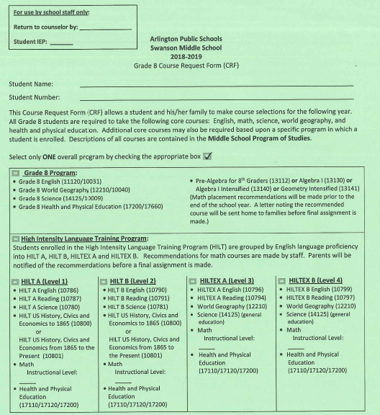
DUE FEB. 22
Turn in CRFs to Counseling Office by Feb. 22
Turn in CRFs to Counseling Office by Feb. 22

Slide 23
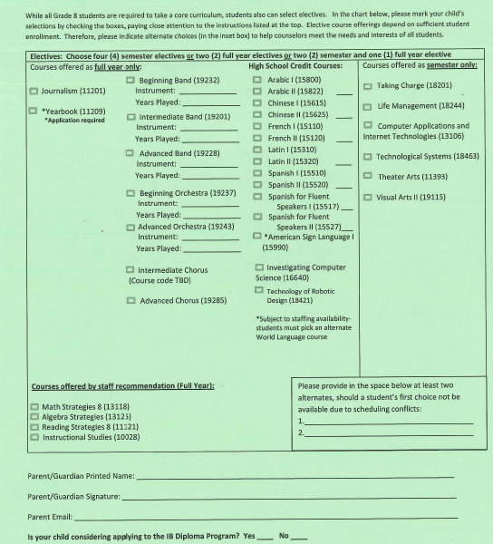
Turn in CRFs to Counseling Office by Feb. 22
Turn in CRFs to Counseling Office by Feb. 22
KG
Theater Arts
Life Management
Due Feb. 24 with Parent Signature
Notes:
Mention HS credit courses

Slide 24
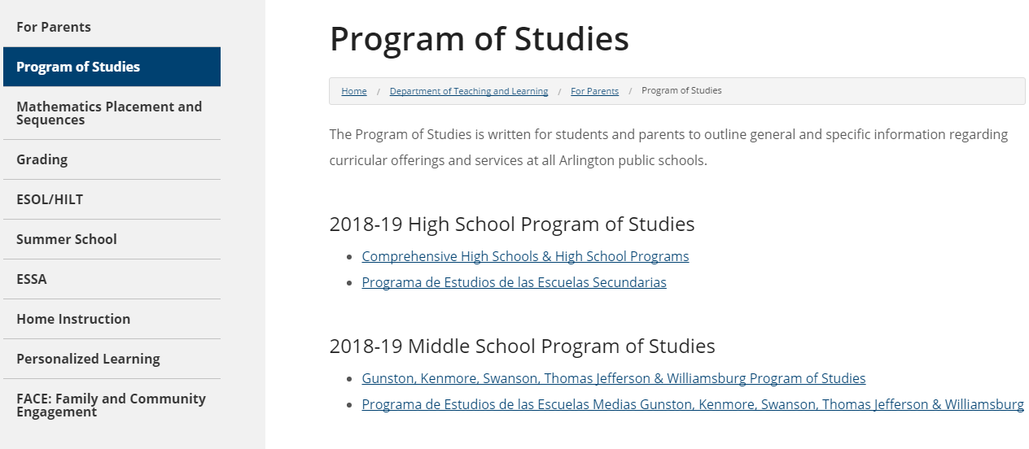
Program of studies
The Program of Studies is available electronically on the APS website
Available on the Department of Instruction page: www.apsva.us/instruction/for-parents/program-of-studies/

Slide 25
Counselor contact information
Mr. Z 703-228-2347 Mohammad.zishhan@apsva.us | Michelle Wilkes 703-228-5511 Michelle.wilkes@apsva.us | Rana Luthra Director of Counseling 703-228-5535 Rana.Luthra@apsva.us

Slide 26
Break Out Sessions
Session 1
7:50 PM to 8:15 PM
World Languages 7th and 8th Grade – Auditorium
Math Curriculum & Placement for 7th and 8th grade – Library
Session 2
8:20 PM to 8:45 PM
World Languages 7th and 8th Grade –Auditorium
Math Curriculum & Placement for 7th and 8th grade – Library

