Slide 1
Making Choices for 7th Grade
Ms. Goodwyn and Ms. Ortiz

Slide 2
Agenda
Today we will discuss:
Courses offerings for 7th grade, including electives
Course request forms
Graduation requirements and academic planning

Slide 3
Seventh Grade Classes
English | U.S History, Civics and Economics 1865-present
Science | Math - Math 7, Pre-Algebra for 7th graders, Intensified Algebra I Recommendations in spring
Elective | Elective
Health and PE

Slide 4
Electives
All students have room for 2 elective classes. These can be filled by:
4 semester classes (2 classes per semester)
2 semester classes, and 1 full-year class
2 full-year classes
Students are asked to rank their choices, and provide alternates
Languages are only offered as full year courses
Math and Reading Strategies letters sent home

Slide 5
Our Instructional Model
2019-20 Swanson will shift to delivering instruction through a “block” model.
School-wide professional learning this year has devoted to studying how to best meet needs of all students

Slide 6
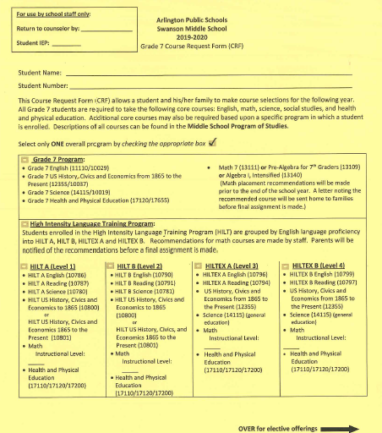

Slide 7
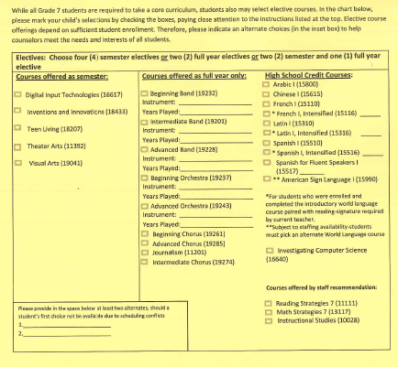
Investigating Computer Science
Journalism

Slide 8
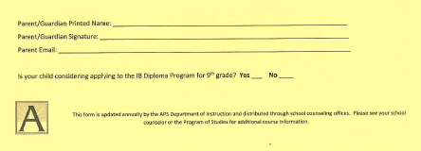

Slide 9
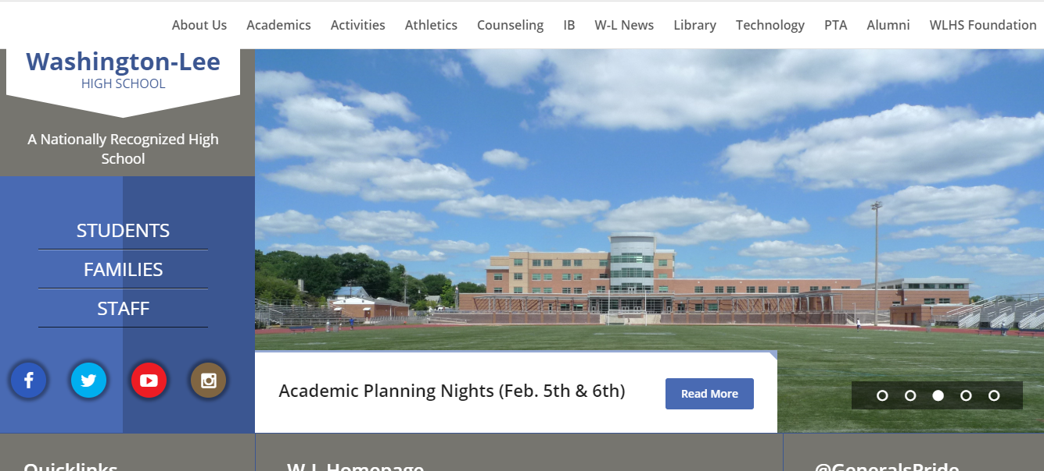
International Baccalaureate (IB)
Important when considering language and math courses
Refer to WL’s website for additional information

Slide 10
Diploma Options
Standard Diploma
22 credits and 5 verified credits
Advanced Studies Diploma
26 credits and 5 verified credits
*Verified credit: received when a student passes the Standards of Learning (SOL) test

Slide 11
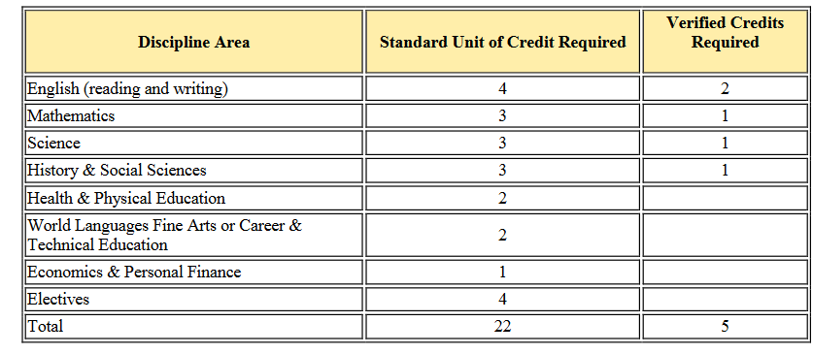
Standard Diploma

Slide 12
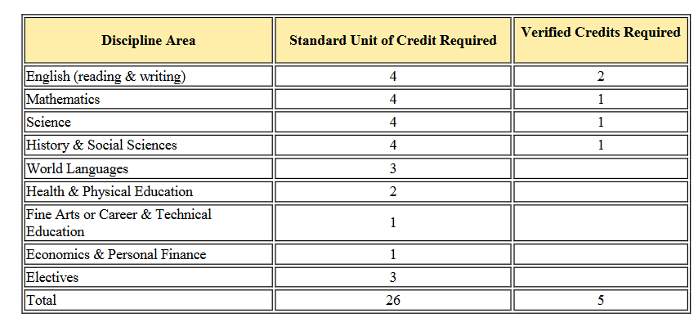
Advanced Diploma

Slide 13
Next Steps
Work with your child to make course selections
If you receive a letter regarding Math Strategies and/or Reading Strategies courses, refer to the letter for who to contact with questions
Students must return their signed CRF no later than February 22
Students will also bring home an academic planning worksheet
In the spring, you will receive a letter regarding math placement

Slide 14
Questions?
Melissa Ortiz (Navigators and Seahawks)
703-228-5509
Melissa.laraortiz@apsva.us
Laura Goodwyn (Mariners and Sailors)
703-228-5519
laura.goodwyn@apsva.us

Slide 15
Break-Out Sessions
Session 1 7:50-8:15 | World Languages - Auditorium | Math - Library
Session 2 8:20-8:45 | World Languages - Auditorium | Math - Library

